Slide 1
Firduino
#IoT Fire Detection App
Εργασία HCI 2021-2022
Εμβολιάδης Αλέξανδρος
Κατσαμπέκης Άγγελος-Ιωάννης
Κύρου Θεολόγος
Παρασκευόπουλος Μιχαήλ
Καθηγητές: Τζοβάρας Δημήτριος
Βότης Κωνσταντίνος

Slide 2
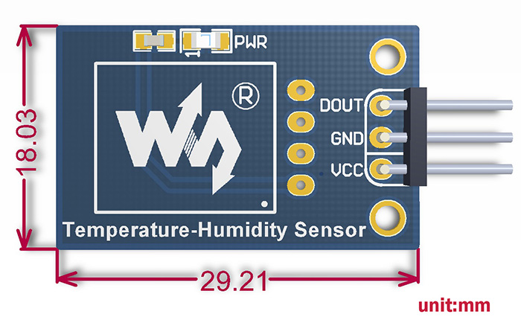
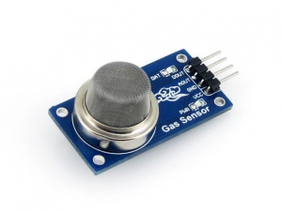


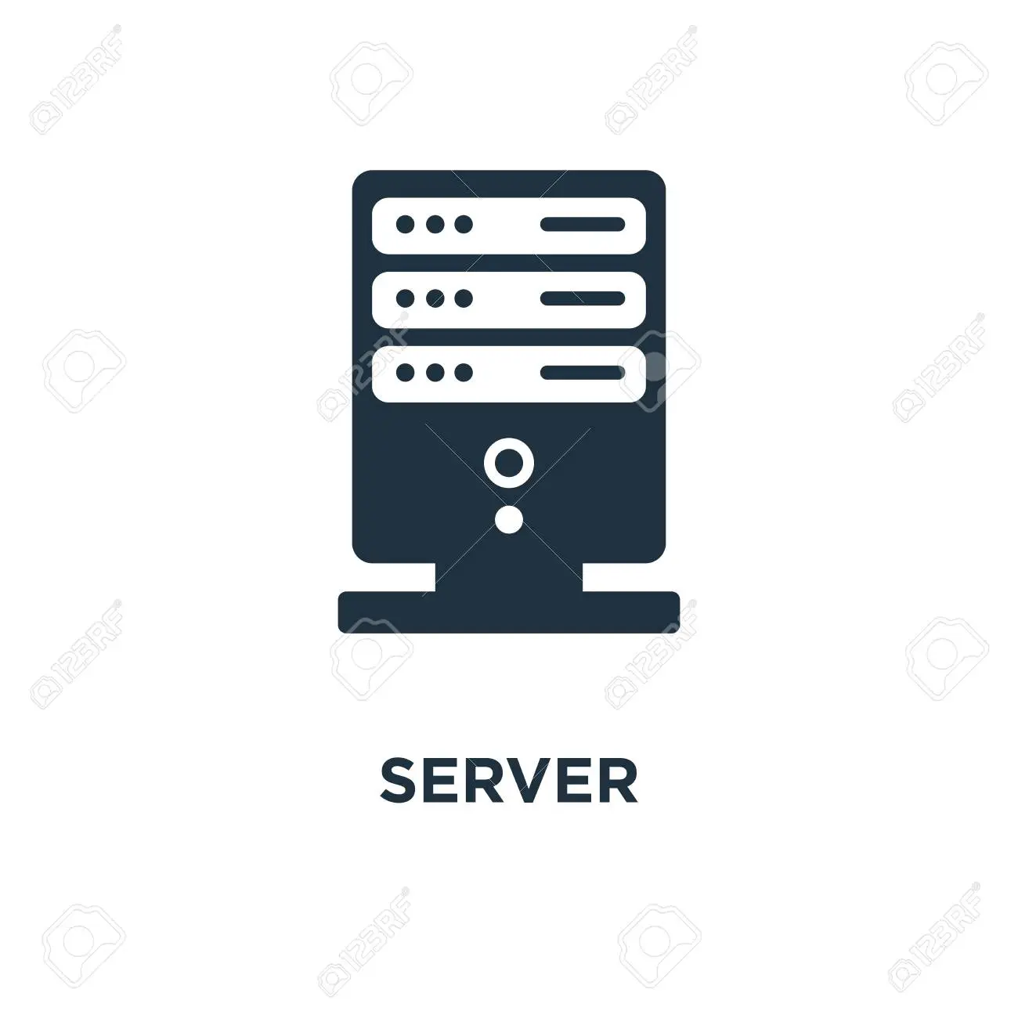
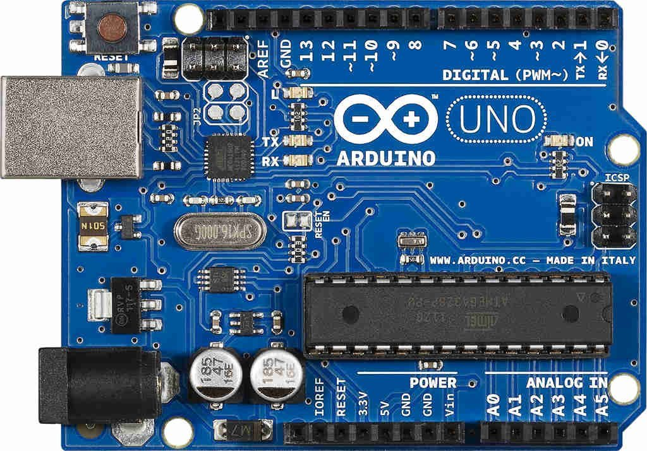


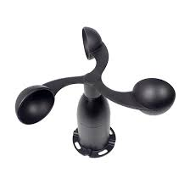
Idea
HTTP REQUEST
FIRE!!!

Slide 3
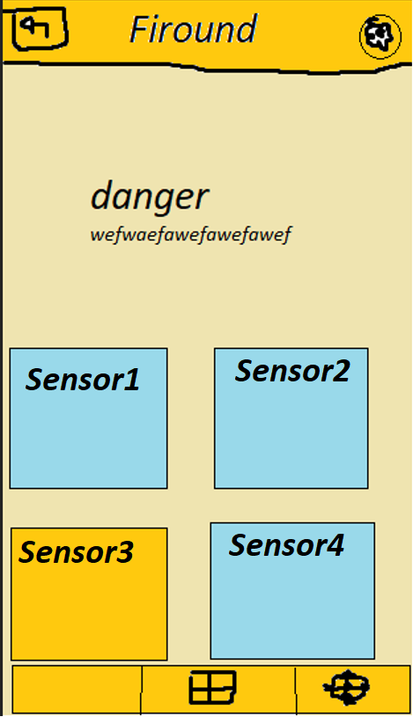
Prototype
Key Points
Understandability
Learnability
Operability
Attractiveness

Slide 4
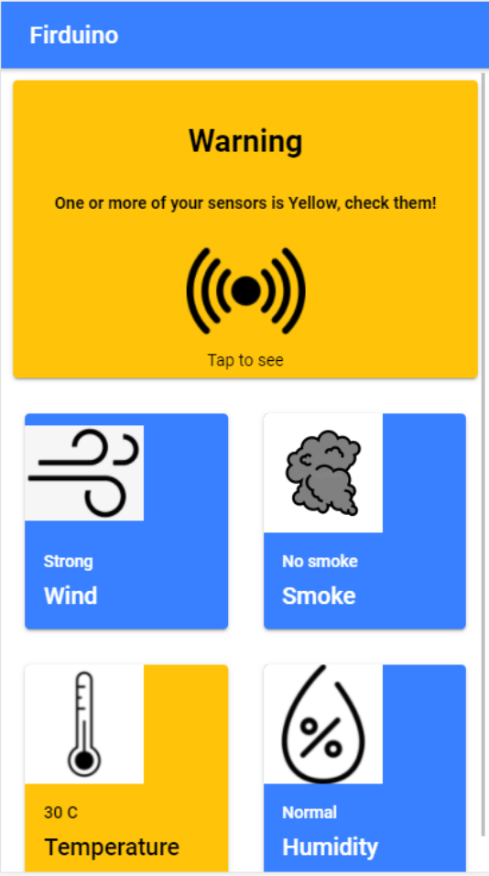
Alpha 1.0
Key Points
Colors
Navigation
Easy to read
Simple

Slide 5
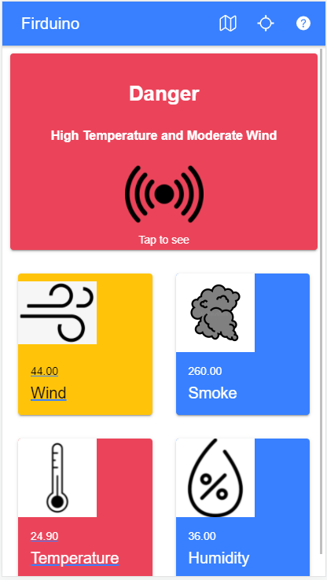
Final
ISO 9126
Key Points
Colors
Navigation
Easy to read
Simple

Slide 6
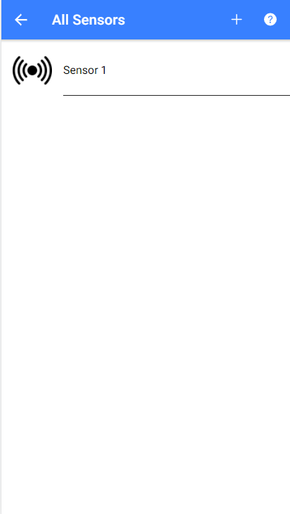
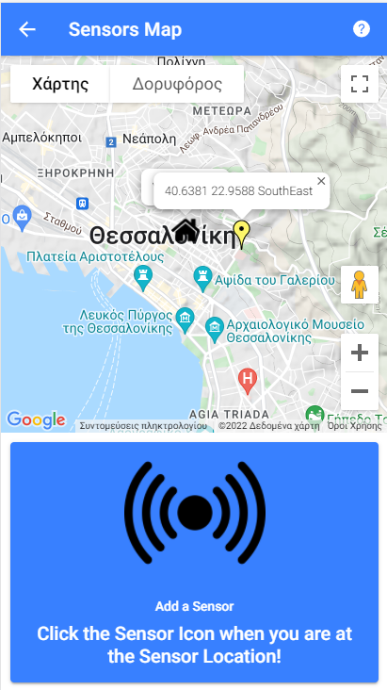
Navigation

Slide 7

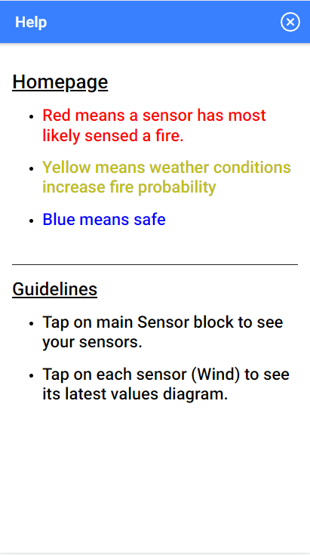
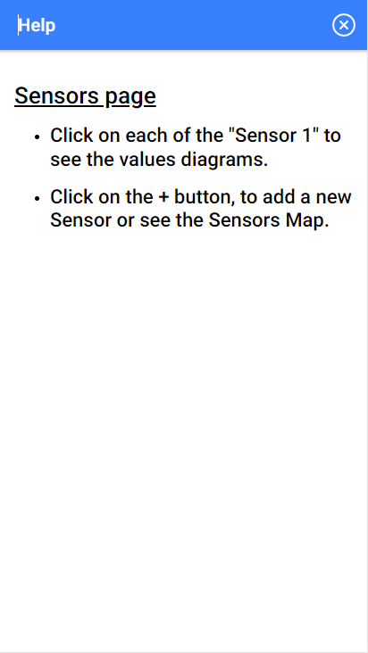
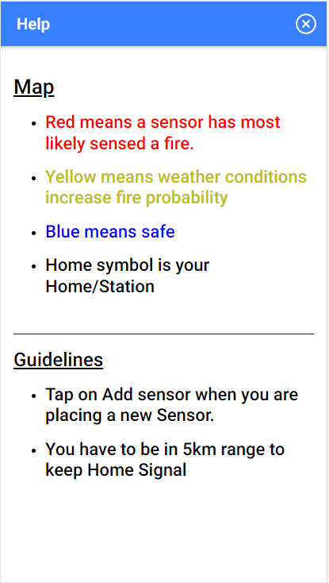
Help Button

Slide 8
Accessibility
Danger! Probable fire coming from SouthEast!
Text-to-Speech
Audio Notifications
Repeated

Slide 9
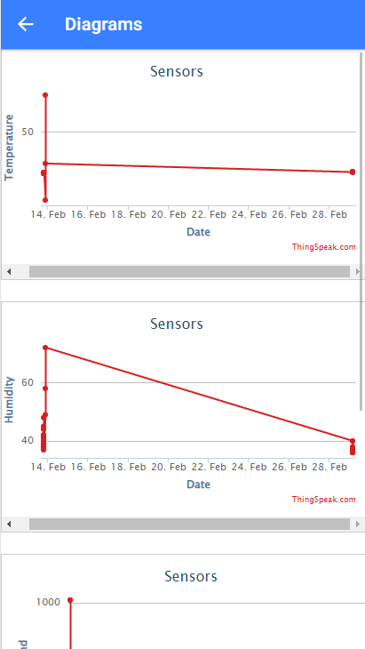
ThingSpeak Diagrams & API
Easy to understand
Reliable
Fast
{"channel":{"id":1642633,"name":"Sensors","latitude":"0.0","longitude":"0.0","field1":"Temperature","field2":"Humidity","field3":"Wind","field4":"Smoke","created_at":"2022-01-28T18:34:43Z","updated_at":"2022-01-29T00:01:13Z","last_entry_id":71},"feeds":[{"created_at":"2022-03-01T02:04:10Z","entry_id":70,"field1":"24.90","field2":"36.00","field3":"26.00","field4":"233.00"},{"created_at":"2022-03-01T02:04:28Z","entry_id":71,"field1":"24.90","field2":"36.00","field3":"44.00","field4":"260.00"}]}

Slide 10
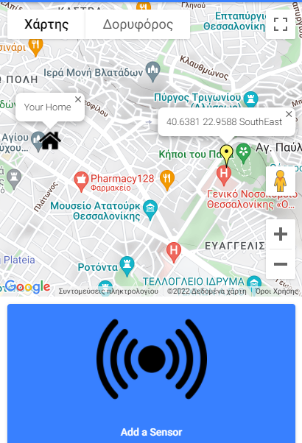
Google Maps + Geolocation
5km
Visualization
Distance
Direction
Colors

Slide 11
Technology Stack
Vue.js
Ionic – Android
Capacitor.js
ThingSpeak IoT Server
Arduino C++
GoogleMaps API
openWeatherMap API

Slide 12
Future Improvements
Login System
Server - More Channels
Push Notification
100% Dynamic

Slide 13
Thank You !
…Any Questions?

